Slide 1
ECE 313: PROBABILITY WITH ENGINEERING APPLICATIONS
Fall 2023
Prof. Eric Chitambar
Lecture 5

Slide 2

Mean of a Random Variable

Slide 3
Mean of a Random Variable

Slide 4






Law of Unconscious Statistician (LOTUS)

Slide 5

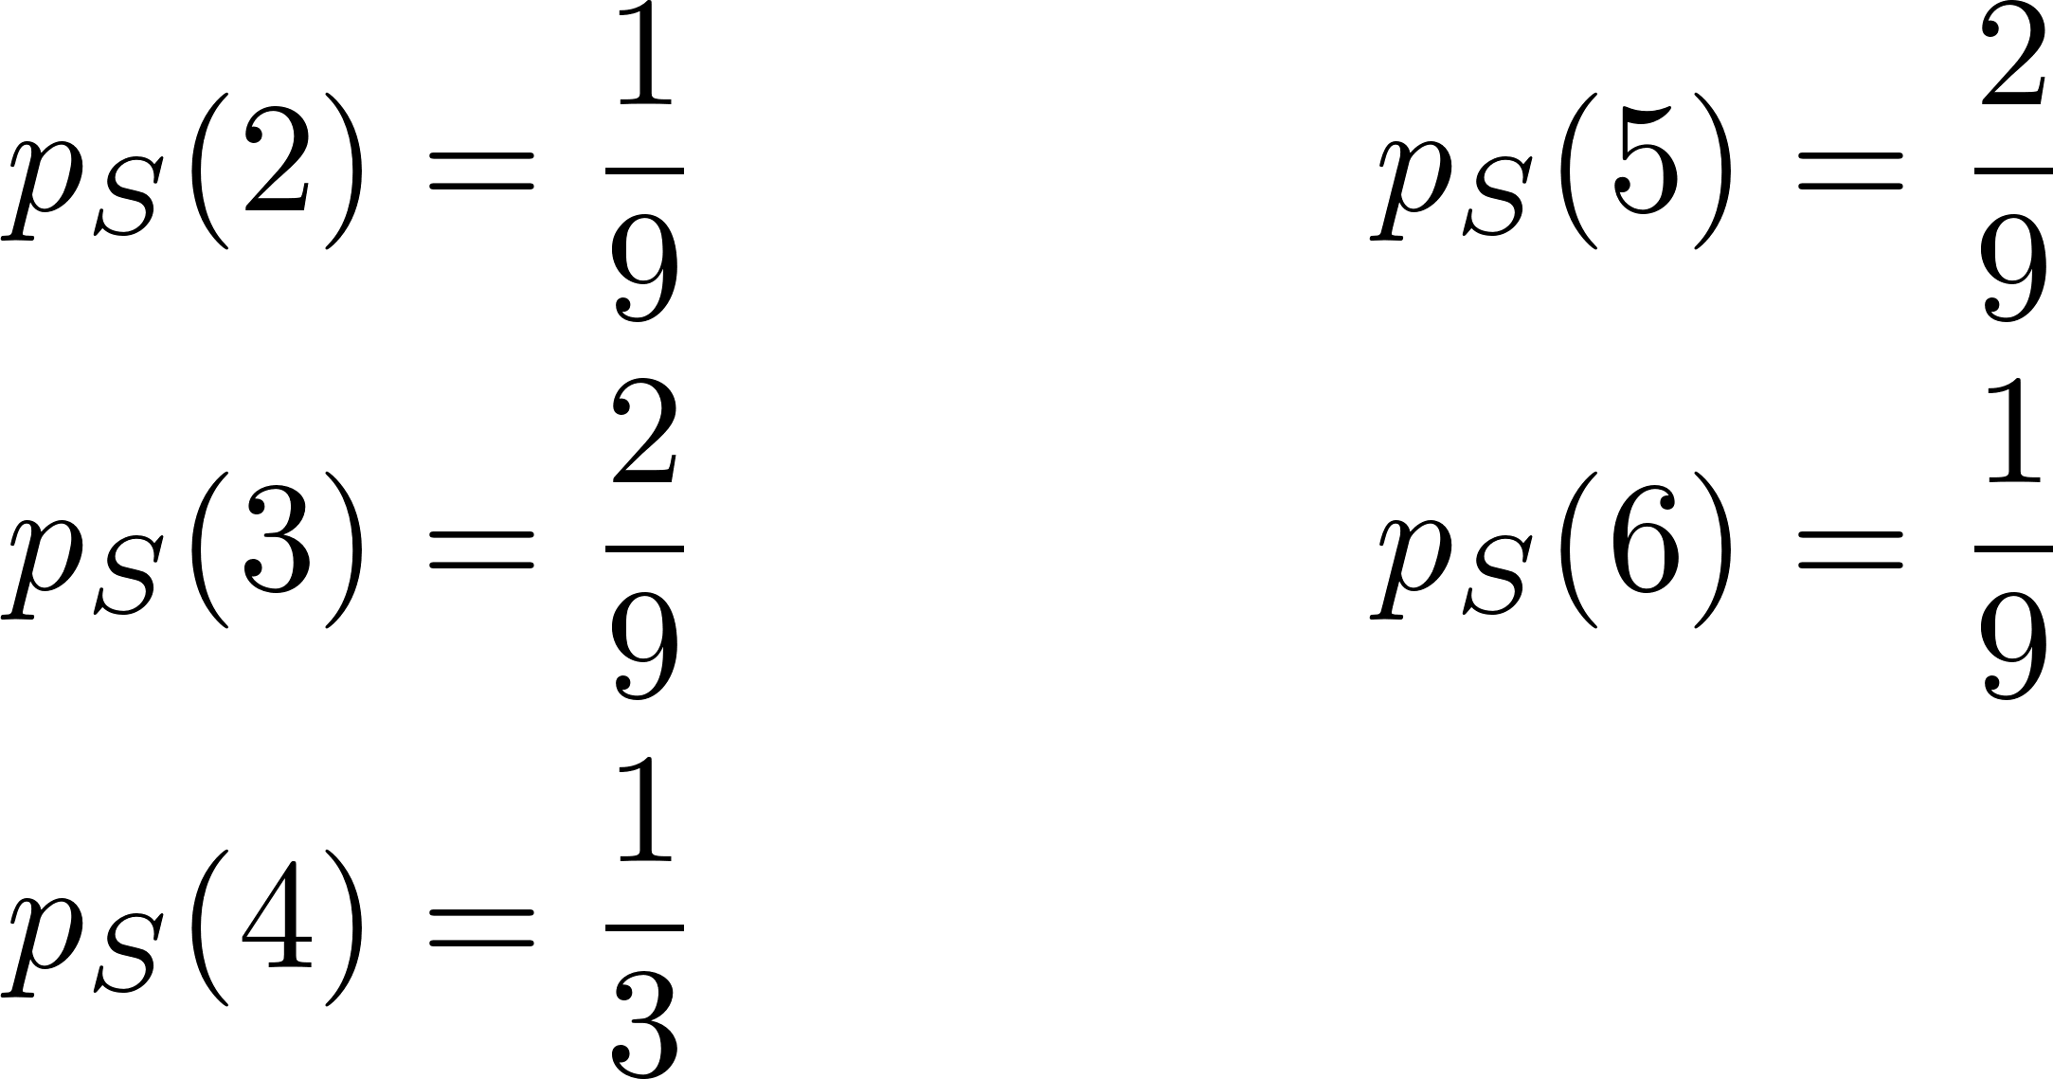
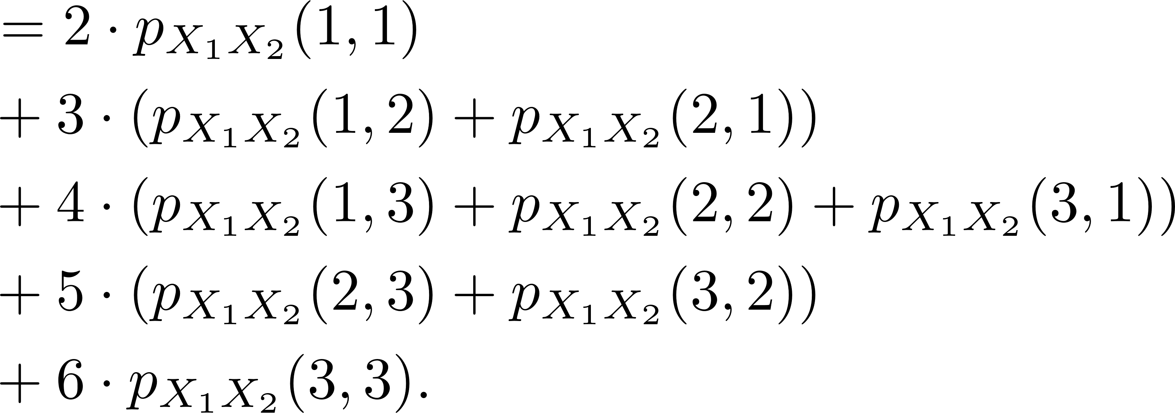
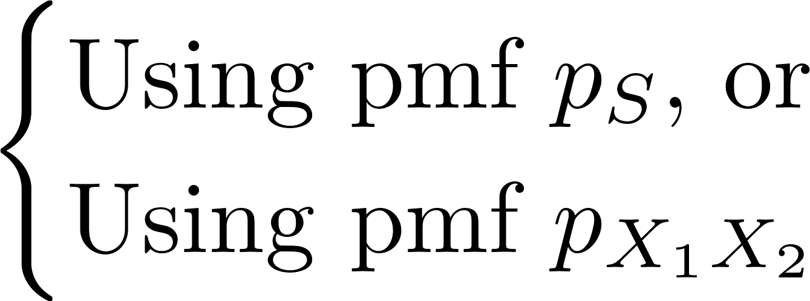

Law of Unconscious Statistician (LOTUS)

Slide 6
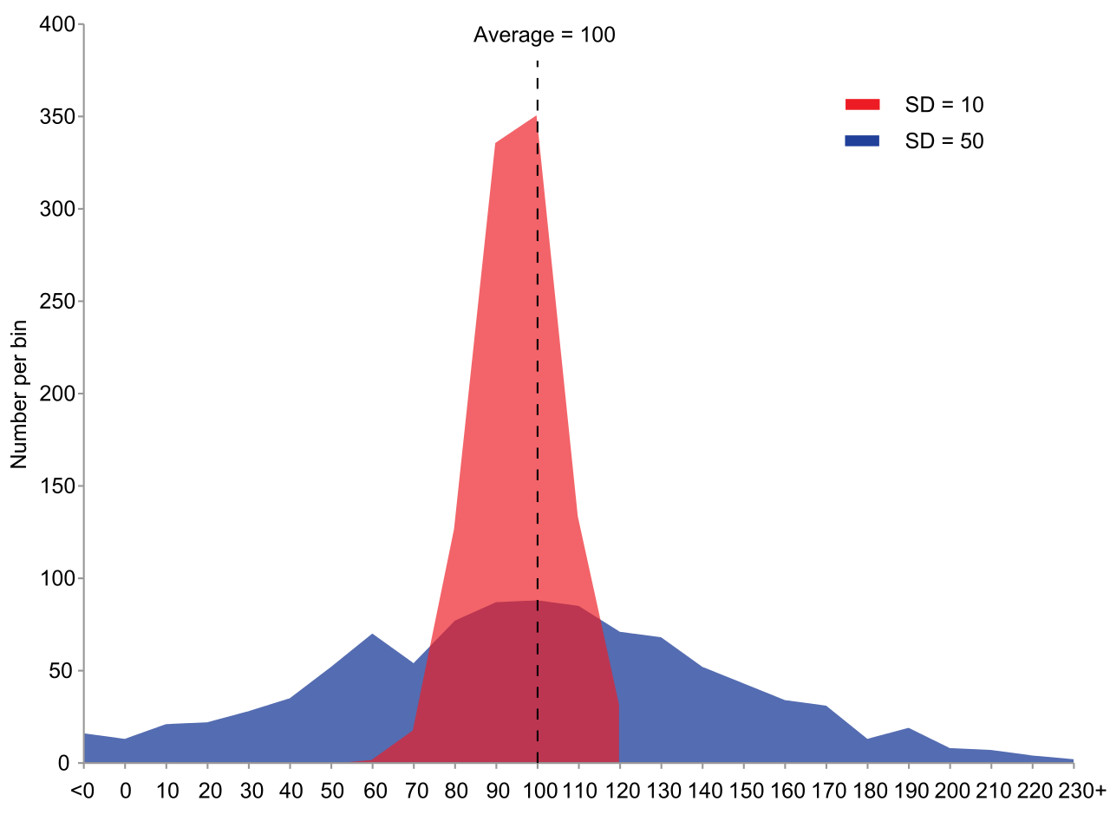


Variance and Standard Deviation
Wikipedia: Variance

Slide 7




Important Properties of Variance

Slide 8
Example Problem

Slide 9
Example Problem

